Slide 1
Gentle Introduction To Machine Learning
Sql Server Saturday
Jamie Dixon
04/11/2017

Slide 2
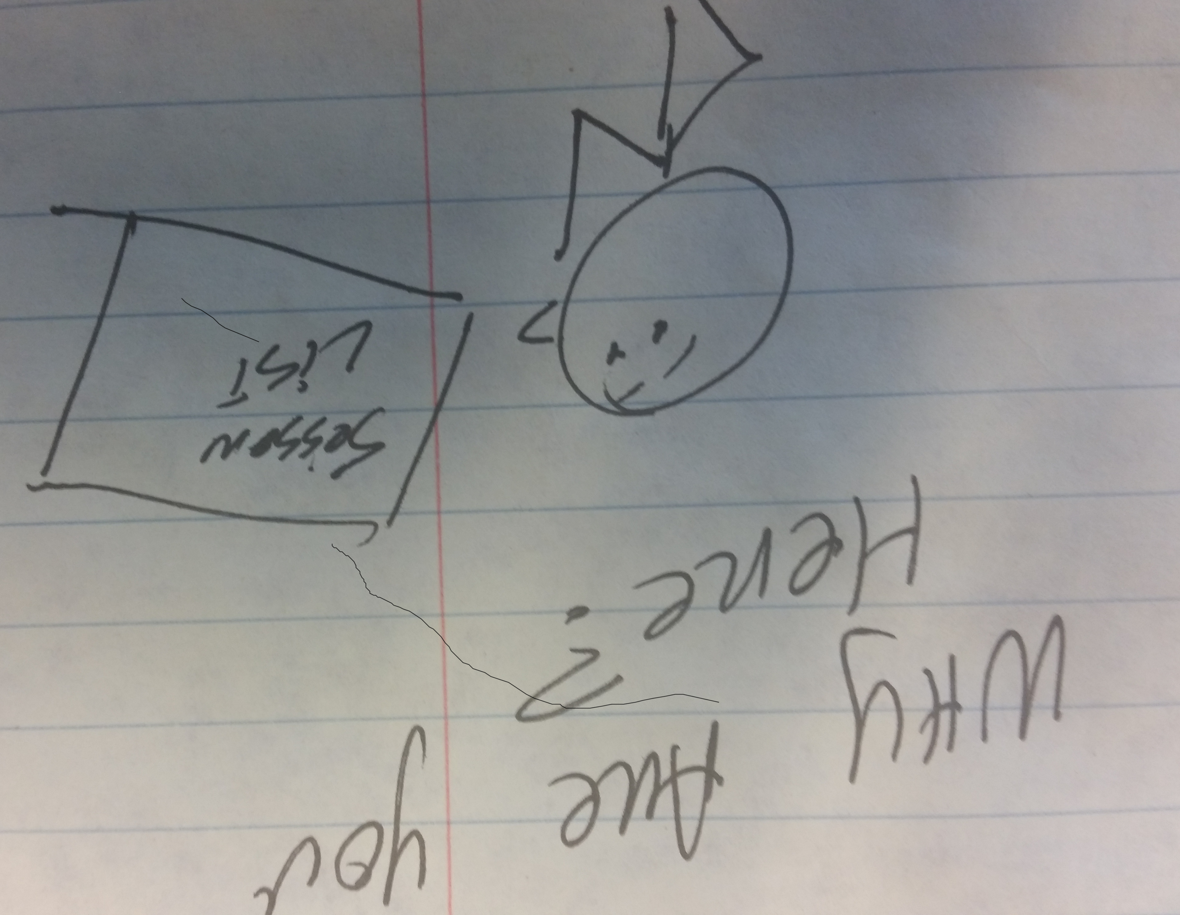
You Are:
A developer wanting to learn about making your applications smarter: the intelligent app is moving CRUD to RIP*
A research analyst/data engineer/report writer being asked to move from descriptive analytics to predictive analytics. “Data Scientist”
Someone who wandered in because the other sessions were full and/or did not look as interesting
*Recommend, Instruct, Predict
Notes:
Recommend
Instruct
Predict

Slide 3
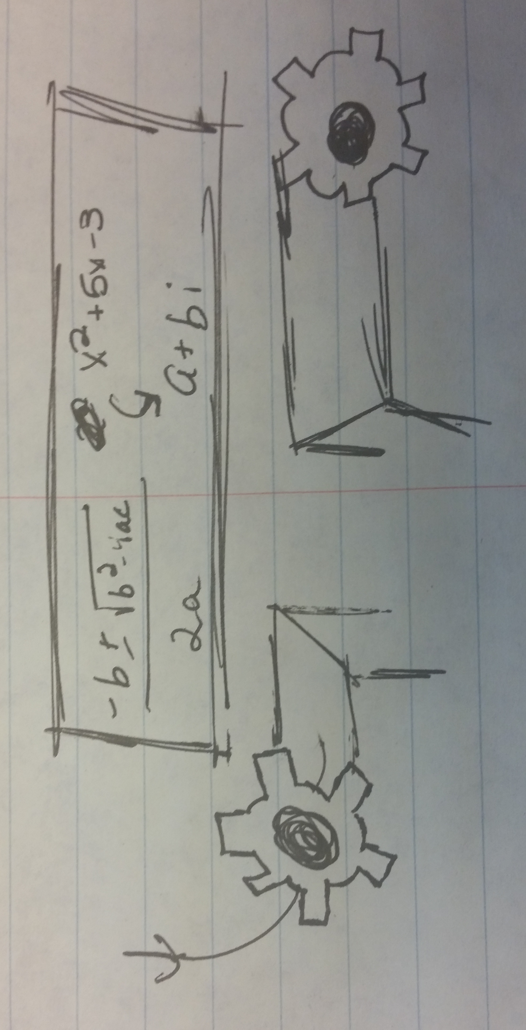
What is Machine Learning?
A technique to train models
A way for applications to change behavior without recompiling.
I, for one, welcome our new overlords
A way for companies to monetize their existing data
A way for cranks to sell more books
Notes:
Yes
No – that is “Intelligent Apps”
No – that is a data science strategy
No – would never lower myself to push out a book to take advantage of a hot buzzword

Slide 4
Common Machine Learning Business Cases
Market Basket Analysis (Cross Selling)
Customer Profiling
Fraud Detection
Sentiment Analysis – Predicting elections
Image/Voice Recognition
Employee Profiling
Existing processes augmented with ML models

Slide 5
Data Science Process
Most important step: Ask Question
Ask Question
Prepare Data
Select Model
Train Model
Test Model
Conclude
Most time-consuming step: Prepare Data
Step most likely to get wrong: Test Model
Notes:
ML is in the training of the model

Slide 6
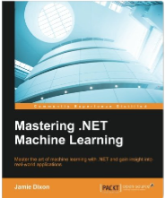
A Word About “Machine Learning”

Slide 7
Types Of Machine Learning
Supervised Learning
Classification
Regression
Unsupervised Learning
Clustering
Outlier Detection

Slide 8
Supervised Learning
Each row of data has features and a value we want to predict/explain
Pass lots of this training data to a ML model. Then feed the model new data without the value and ask it to predict
Year | Make | Model | Miles | Color | Condition | Price
2014 | Honda | Accord | 30,000 | Silver | Good | $21,000
2013 | Toyota | Camery | 40,000 | White | Great | $19,000
2012 | Honda | Accord | 20,000 | Black | Great | $22,000
2015 | Toyota | Camery | 10,000 | Silver | Great | ?

Slide 9
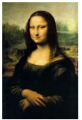

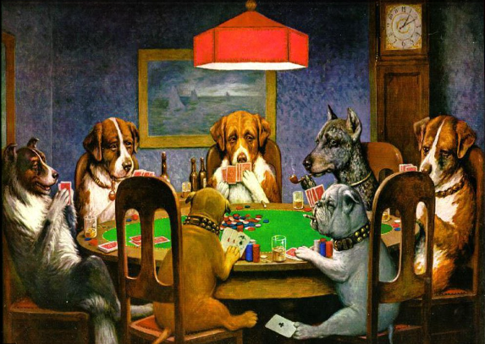


Unsupervised Learning
We pass data to an ML model and the model finds similar features within the dataset

Slide 10
Regression v Classification
Regression: outcome is a continuous value
Predict average temperature
Predict number of sales next month
Predict MPG of a car
Classification: outcome is placed into a category
Binary classification: only two possible outcomes
Heads or Tails, Red State or Blue State
Multi-class classification: more than two possible outcomes
Abort, retry, fail

Slide 11
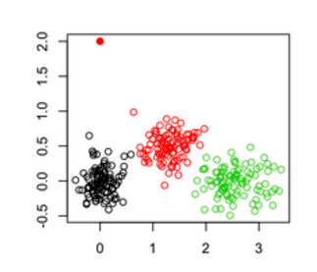
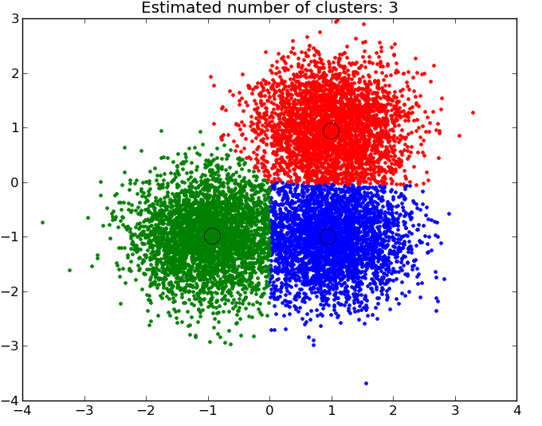
Clustering V Outlier Detection
Clustering puts the data points into clusters based on similarities
Outlier Detection finds abnormal data points

Slide 12
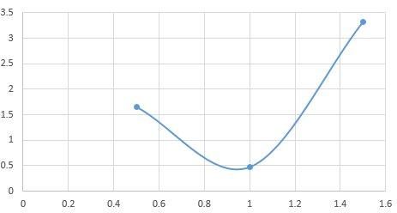
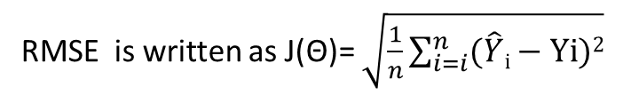
The Cost Function
Cost functions are typically written as J(θ₀,θ₁…θ_{n}) where each θ is a parameter of the regression function
You can graph the cost function based on different possibilities of the hypothesis function (your regression)
θ1=1 | θ1=0.5 | θ1=1.5
0 | 0 | 0
1 | 0.5 | 1.5
2 | 1 | 3
3 | 1.5 | 4.5
4 | 2 | 6
5 | 2.5 | 7.5
0.47 | 1.66 | 3.32
RMSE is written as J(Θ)= $\sqrt{\frac{1}{n}\sum_{i=i}^{n}{(\hat{Y}i−Yi)2}}$
Holding θ₀ constant at 0
Notes:
Gradient descent

Slide 13
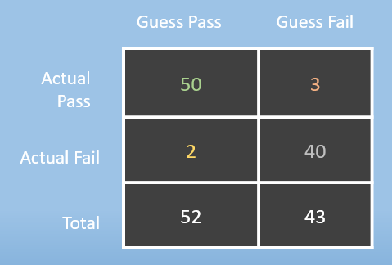
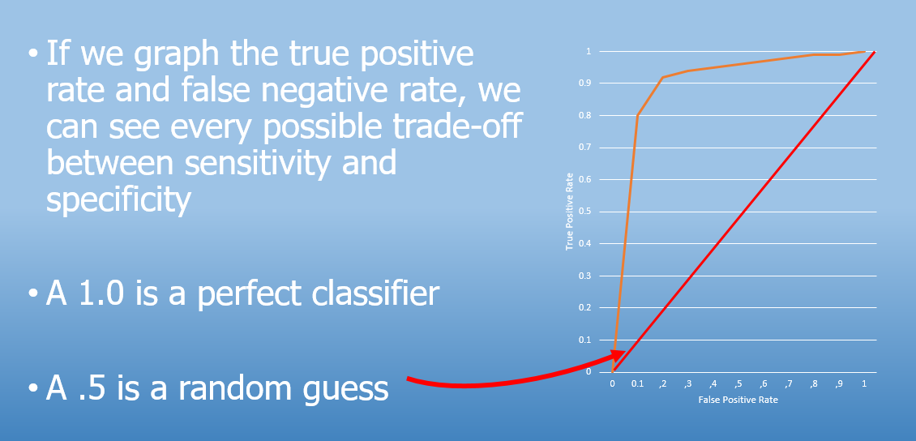
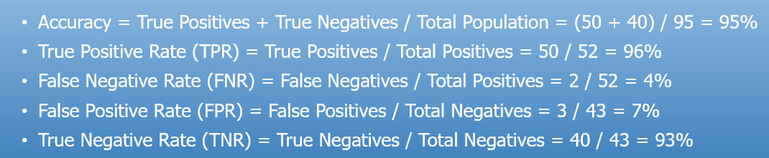
Classification Cost Function
Notes:
Let’s say we ran a logistic regression against 95 students to predict if they passed or failed an exam. We then compared the prediction to the actual results and put the values into a confusion matrix

Slide 14
Collinearity and Confounding
What you are trying to explain: dependent variable
What is doing the explaining: independent variable
When two independent variables are related: Collinear
Age and Height in middle schools explain reading level
When a variable that is not being measured affects the independent and dependent variable: Confounding
Ice Cream Sales explain Shark Attacks

Slide 15
Explain V Predict
Your analysis might try to understand a past event
When we have pictures of cats on our website, sales increased 10%
Your analysis might try and predict a future event
Our sales next quarter will be up 5%
Correlation (using observational data)
Causation (using experimental data)
Most common is A/B testing

Slide 16
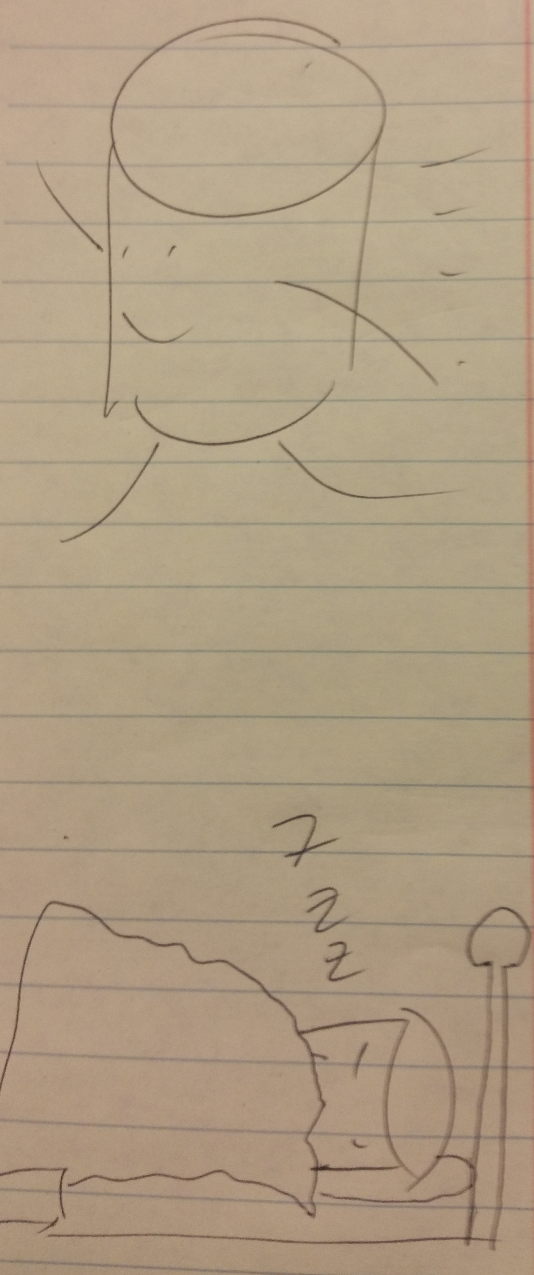
A Word About “Conclude”
Used to look at it and perhaps change
Ad-hoc analysis
Weights were put into prod
Now, more likely to be retrained
Analyze data in motion: Stream processing
Analyze data at rest: Batch processing

Slide 17

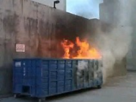
Ready For ML?
ETL -> ELt
Question is clearly defined (“sharp”)
Data matches the question
Data is accurate
Have enough data?

Slide 18
Build V Buy
SAS
SPSS (IBM)
MatLab
Azure ML
IBM Watson/Blue Mix
AWS ML
Excel
Rapid Miner
Tableau
Sql Server
Hadoop + Spark
R
Python

Slide 19
ML on Sql Server
Example in 5 minutes

Slide 20
Conclusion
Nail the question, the rest will follow
The more willing you are to learn, the better off you will be
Companies are not “one tool away” from a strategic advantage, but they might be “one team away”
@jamie_dixon
https://github.com/jamessdixon/SqlSaturday.Raleigh.2017

